Slide 1
TX/RX Part 2:
AI Audio on the Raspberry Pi
Kieran Coulter | Principal Systems Software Developer - Audio
Audio Developer Conference Japan 2026
github.com/kcoul/JUCE4Pi

Slide 2


Slide 3
Agenda
Section 1. | The Story So Far
Section 2. | JUCE on QNX
Section 3. | Audio on the NPU
Section 4. | Developing Host-First
Section 5. | Getting to the Target
Section 6. | From R&D to Production

Slide 4
The Development Journey
JUCE Port to QNX
NPU Research
Bridge Workbench
Dual-Pi Evaluation
SurgeXT stress test · Pi4
Whisper · Hailo · Qualcomm
MIDI-OSC + Voice · host-first
Pi4 QNX · Pi5 Ubuntu + NPU
From R&D to Production
DataBridge
VREngine
GENISYS
AVAS/ESE · Pi4 QNX
Voice recognition · Pi5 Ubuntu
Studio system · Pi5 backend

Slide 5
The Story So Far
Section 1.

Slide 6
Recap
IDE on Target
When starting out, connect the IDE to target filesystem and compile directly on-device — no cross-compilation needed
GPIO & pigpio
Hands-on GPIO examples: reading a potentiometer in C with the pigpio library
ADC'21
C / C++ Interop
Mapping C++ member functions to C function pointers via a Callback<> template — required to bind C functions to C++ class methods
Start Small
Many small programs better than large ambitious project when learning embedded basics

Slide 7
Recap
The Project
NeuralPlayer — AI-enhanced music player combining Stem Separation and Audio-to-MIDI conversion models
The Philosophy
Pure R&D belongs on the host: no target hardware, no cross-compilation, no embedded constraints
ADCx'23
Optimize for Target (not Host)
Move to target only once project is ready for optimization
Coming in Future Talk
NeuralPlayer didn't stop here — next talk will reveal the evolution of this project

Slide 8
JUCE on QNX
Section 2.

Slide 9
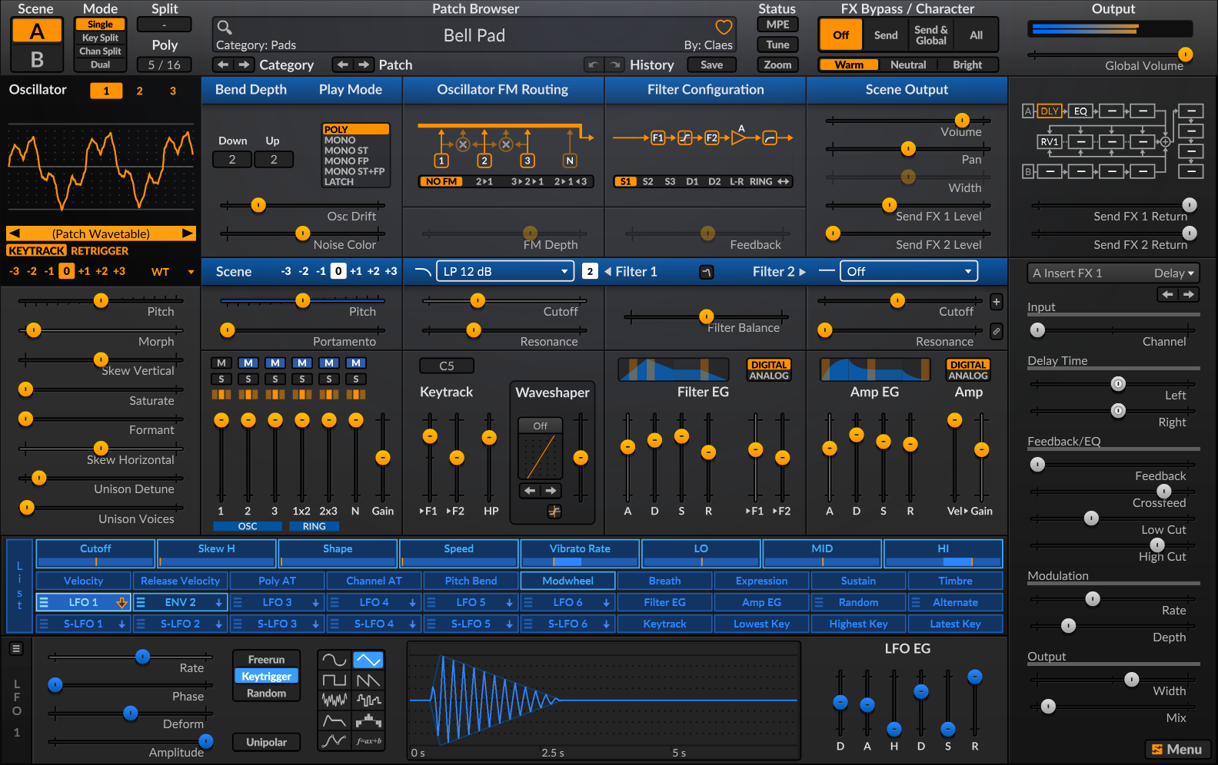
QNX Everywhere
QNX's initiative to run on any CPU, any board, any use case
Elk Audio OS already runs headless JUCE on a real-time OS — that part is solved
JUCE with full module set now runs on QNX - including GUI modules
SurgeXT on Pi 4/5 running QNX served as a great stress test
Work ongoing to improve OpenGL framerate - watch JUCE4Pi repo for updates

Slide 10
Build Target Matrix
QNX · Pi 4
Ubuntu · Pi 5
Host
SurgeXT
SurgeXT
SurgeXT
frame rate comparison →
SurgeMIDIToOscBridge
SurgeMIDIToOscBridge
DataBridge
native · Hailo NPU available
VREngine
GENISYS
Every target includes:
Multi-arch targets pass --target <target> to select the toolchain:
linux · aarch64-linux GCC
build.sh
deploy.py
./build.sh --target <target>
qnx · aarch64 QNX SDK

Slide 11
Lessons from the Port
What worked quickly
ALSA — QNX supports it natively; existing Linux backend adapted in one day
juce_core — POSIX base transferred almost directly
Tracktion Engine — ported the same day as JUCE audio
What took time
The Screen Framework — new ComponentPeer from scratch
11 commits · 2,433 lines · 2+ weeks
Layers: Screen FW → keyboard/mouse → fonts → OpenGL → secondary windows
Cross-compilation setup: aarch64 Ubuntu on WSL2 (Ubuntu Noble)
1
2
3
Restrict native repo
ubuntu.sources
Add: Architectures: amd64
Prevents apt mixing host and target libs
Add arm64 ports
ubuntu-arm64-ports.sources
URIs: ports.ubuntu.com/ubuntu-ports
Architectures: arm64
Install toolchain
dpkg + apt
dpkg --add-architecture arm64
apt install gcc-aarch64-linux-gnu
g++-aarch64-linux-gnu
libasound2-dev:arm64
Check the docs folder for SurgeMIDIToOscBridge for more details

Slide 12
JUCE ↔ QNX: The Screen Architecture
JUCE APPLICATION
juce::Component
juce::OpenGLContext
createPeer()
attaches to
QNX PORT — juce_Windowing_qnx.cpp + juce_OpenGL_qnx.h
QnxComponentPeer
(: ComponentPeer)
SharedQnxScreen
EventThread
OpenGLContext::
NativeContext
register
↓ getNativeHandle() → screen_window_t
QNX SCREEN FRAMEWORK
EGL / OpenGL ES
screen_context_t
(shared, ref-counted)
screen_window_t
(windowing + EGL surface)
EGLDisplay + EGLSurface
+ eglSwapBuffers()

Slide 13
Bonus: Tracktion Engine on QNX
Timeline-based audio engine running on target useful for eval
"Why You Shouldn't Write a DAW" — David Rowland, ADC23 — exactly how we're thinking about this
No MIDI on QNX? OSC over UDP closer protocol fit to automotive data buses than MIDI anyway
OSC as a surrogate for real automotive data streams like CAN, VIN, etc.
Ref: youtube.com/watch?v=GMlnh6_9aTc

Slide 14
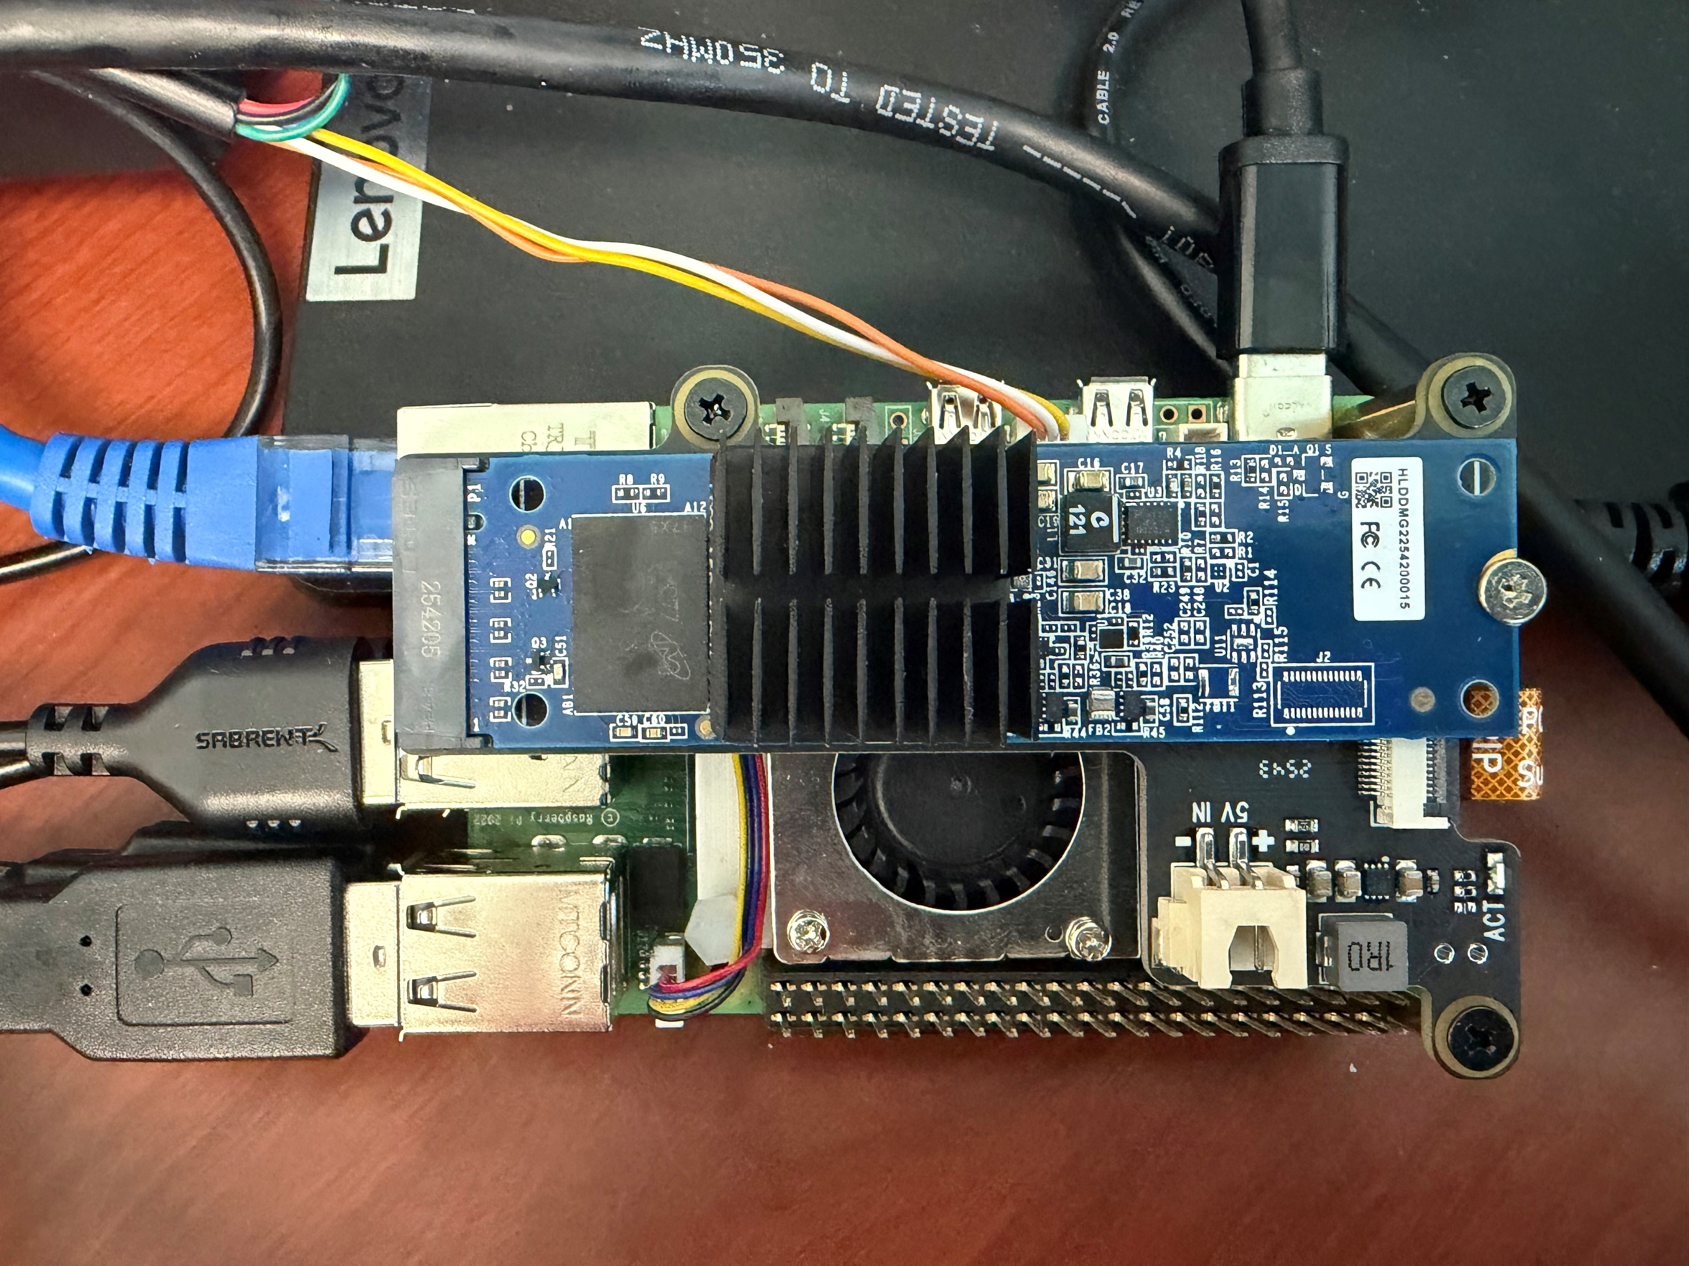
Audio on the NPU
Section 3.

Slide 15
Audio on the NPU — Pros & Cons
"NPUs shine with low-latency, single-inference tasks — think real-time audio cleanup or live transcription during video calls. One client in the film industry reduced their audio processing time by over 70%…"
"memory bandwidth matters more than raw compute for many NPU workloads"
Added complexity of communication between the CPU and NPU
Source: ordinarytech.ca — On-device AI in 2026: How NPUs are Transforming AI PCs for Creators and Power Users

Slide 16
Hailo 10-H: NPU Bring-Up
1
STEP 1
2
STEP 2
3
STEP 3
Windows Host
Windows 11
whisper.cpp on CPU — first working prototype
No NPU in the loop initially
CPU-based voice API for bridge tool coded here
Hailo backend deliberately disabled
Ubuntu Dev Host
Native Linux
Hailo M.2 in the dev laptop
HailoRT SDK and arm64 sysroot configured
NPU inference integrated into the Bridge
Full pipeline validated on the host first
Ubuntu Target
Raspberry Pi 5
Same Hailo-10H, now on target
Hailo-10H over PCIe via Geekworm X1001
Host pipeline moves to target unchanged
NPU bring-up complete
Bonus: Hailo support added to Windows

Slide 17
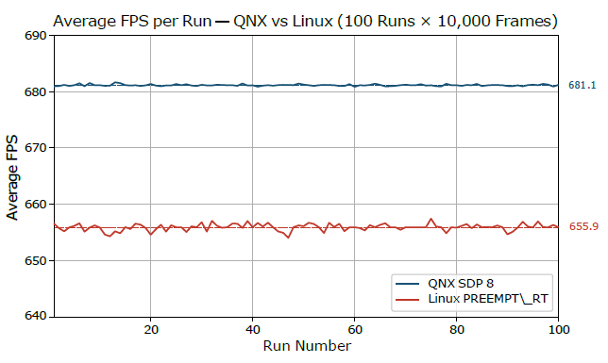
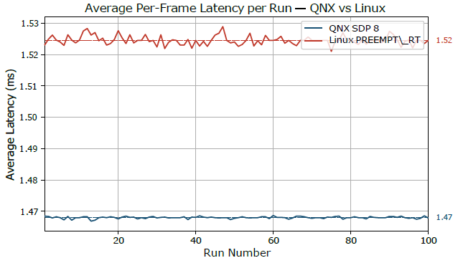
QNX NPU Status
• QNX supports Hailo-8 and Hailo-8L today — Hailo-10H support coming in future package
• Comparison of workloads on 1st-gen Hailo NPUs promising on QNX vs PREEMPT_RT Linux [1]
[1] PhyAI Foundation — QNX vs PREEMPT_RT Linux MobileNetv1 Benchmark (publication forthcoming)

Slide 18
Faster on the NPU
Whisper on Target CPU — baseline
Transcription latency: ~3 seconds per command (single-core) - too slow!
RPi5 ARM core peak/median load less predictable
SurgeXT audio competes for the same cores
Contention could cause artifacts at lower buffer sizes
Whisper on Hailo 10-H
Transcription latency: ~300 milliseconds per command (no optimization)
UX now within realm of usability for intended application
CPU load predictable again, relative to number of active voices
Lowest buffer size RPi5 capable of once again possible

Slide 19
Developing Host-First
Section 4.

Slide 20
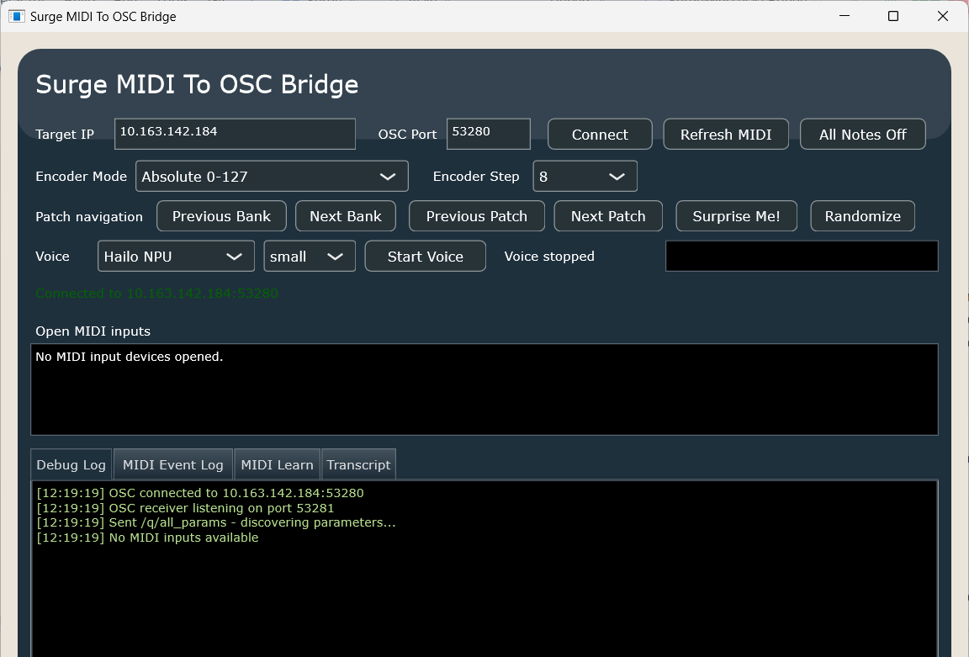
SurgeMIDIToOSCBridge: One Tool, Two Roles
Role 1: MIDI → OSC
MIDI has no role in automotive — QNX doesn't support it
Bridge translates controller MIDI input to OSC messages
SurgeXT already speaks OSC natively — no synth changes needed
Solves the QNX MIDI gap without touching the target
Role 2: Voice API Prototype
whisper.cpp integrated into the same binary
Develop and validate the voice pipeline on the Host
Same binary deploys to the Target unchanged
One tool, both roles — convenience, not architecture

Slide 21
Bridge: MIDI → OSC Feature Set
Initial Testing
Note On/Off + velocity → /mnote/{on|off}
8-control CC macro banks
X/Y touchpad
Patch/Bank change messages
Towards GENISYS
MIDI Learn for any OSC destination
Prototype 'Studio Builder' wizard with available controllers

Slide 22
Bridge: Voice API Feature Set
Patch Control
Load patch by name → /patch/load [name]
Step through patches → /patch/{incr|decr}
Browse by category → /patch/{incr|decr}_category
Surprise me → /patch/random
Sound Shaping
Named macros 1–8 → /param/macro/N ("more brightness")
Global volume → /param/global/volume
FX bypass by slot → /param/fx/{scene}/{slot}/deactivate
Any parameter by OSC address → /param/...

Slide 23
Getting to the Target
Section 5.

Slide 24
The Bridge — How We Got to the Target
One tool, four stages
Stage 1 — MIDI gap: Bridge translates Host MIDI → Target OSC. SurgeXT already speaks OSC — no changes needed
Stage 2 — Voice on Host: add whisper.cpp. Same OSC path, new input source
Stage 3 — Host NPU: BRIDGE_HAS_HAILO=1. Same app, Hailo backend
Stage 4 — Move to Target: redeploy Bridge to RPi5. Nothing else changes
Why 3 NPUs made this possible
Hailo M.2: same chip in dev laptop and in the RPi5 M.2 hat
Validate NPU inference on the host — no SSH, no cross-compile, no target in the loop
Never fight remote-dev issues and novel hardware at the same time
One NPU per stage: Windows → Ubuntu → RPi5

Slide 25
Host / Target Support Matrix
HOSTS
TARGETS
1
STEP 1
2
STEP 2
3
STEP 3
4
STEP 4
Windows Host
Windows 11
CPU whisper.cpp works natively — stepping stone to NPU
HailoRT now builds natively — COM header workaround needed
Cross-compilation for arm64 requires WSL2
HailoRT PCIe driver unavailable under WSL2
Ubuntu Host
Native Linux or WSL2
Uses apt multiarch packages
Cross-compiles for Ubuntu arm64
Links the HailoRT arm64 sysroot
Cross-compiles Hailo binary for RPi5
Ubuntu Target
Raspberry Pi 5
Runs the Linux arm64 bridge
Hailo-10H over PCIe via Geekworm X1001 hat
CPU/NPU benchmarks matter most here
Same NPU on host and target is key
QNX Target
Raspberry Pi 5
Runs SurgeXT on QNX
Uses the QNX cross SDK
Keeps the same host-first workflow

Slide 26
How It All Fits Together
HOST
TARGET (QNX / RPi5)
Voice
Input
Whisper
Hailo NPU
Prog +
Bank Change
MIDI > OSC
Bridge
SurgeXT
Audio
Output

Slide 27
The Full System on Target
TARGET (QNX / RPi5)
Voice
Input
Whisper
Hailo NPU
Prog +
Bank Change
MIDI > OSC
Bridge
SurgeXT
Audio
Output

Slide 28
From R&D to Production
Section 6.

Slide 29
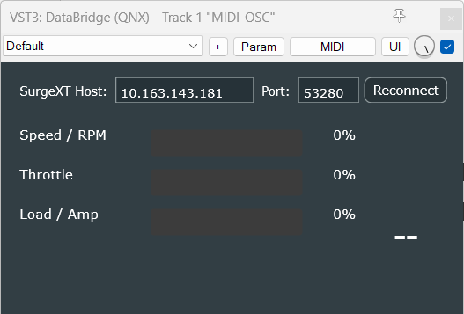
DataBridge: Exercise in Adapting Protocols
The problem
QNX has no MIDI stack — OSC is a closer fit on automotive
Automotive protocol adapters are routine (CAN, AWE, RCS/ACS)
Needed a way to feed live control data to SurgeXT on target
Building a MIDI→OSC bridge was a practical exercise
What it is (and isn't)
VST3 plugin: translates MIDI CC into OSC messages
Convenient for testing AVAS/ESE DSP using MIDI via DAW
Not a production tool — utility that taught OSC and the protocol layer
Understand generalization of message protocol adapters

Slide 30
VREngine: Voice Commands on Target
What it demonstrates
Always-on voice recognition at automotive latency budgets
Whisper on Hailo NPU: ~300 ms vs ~3 s on CPU
Mock of tiny part of automotive head unit dashboard
Keyword match routes commands to SurgeXT patch loads
The sound profile demo
Say "ice" → SurgeXT loads ICE patch
Say "modern" → SurgeXT loads Modern patch
Manual toggle buttons for user touchscreen — same OSC route regardless
Runs on host for dev; cross-compiles to RPi5/QNX

Slide 31
GENISYS: Talk to Your Entire Studio
Jason's dream is finally possible in 2026
A Raspberry Pi that knows your entire studio
Any input (MIDI, voice, UI) routed to any destination
Studio Builder wizard defines your room once
What we have right now: 'OSC Learn' for SurgeXT Standalone, MIDI-OSC and Voice-OSC bindings
Down the line: Intent -> Parameter Space — tweak your tracks by describing what you want
Why don’t we use AI to build tools that help human artists and musicians make even more art and music that actually moves our souls?
Looking for Open-Source Developers to contribute to GENISYS — contact me to get in touch!

Slide 32
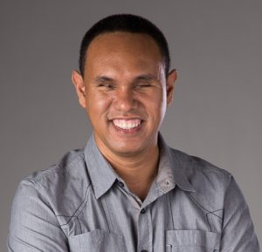
Dedicated to Jason Dasent
jasondasent.com

Slide 33
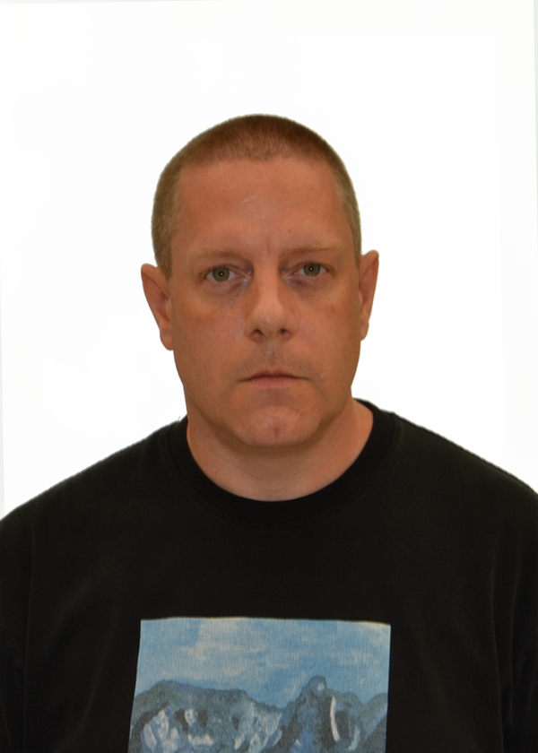
Thank you
Kieran Coulter
Principal Systems Software Engineer - Audio
GitHub https://github.com/kcoul
E-Mail kieran.coulter@gmail.com

